Slide 1
PRODUCT QUALITY ANALYSIS
TEAM MEMBERS
113320243009 - DURAI RAJ A
113320243010 - HARIHARAN K

Slide 2
Objective
The Product Quality Analysis System improves manufacturing standards by ensuring thorough quality control. It uses advanced analytics to provide immediate insights and identify defects proactively. Integrated seamlessly into workflows, it encourages continuous improvement, serving as a vital tool for achieving exceptional product quality in businesses.

Slide 3
Abstract
The Product Quality Analysis System is a thorough solution that evaluates and improves the quality of manufacturing processes by efficiently handling tasks, samples, defects, and errors throughout production. Using advanced analytics, it calculates a dynamic quality score, offering real-time insights. Easily fitting into workflows with a user-friendly interface, it allows systematic tracking to identify patterns, foresee issues, and optimize processes. The quality score acts as an important metric for quick decision-making and ongoing improvement, empowering businesses to proactively enhance their product quality standards with a focus on accuracy and efficiency.

Slide 4
Existing System
Disadvantages
The Product Quality Analysis System addresses the limitations of current manufacturing quality control by offering a comprehensive solution with real-time monitoring, proactive defect identification, seamless integration of data analytics, and a user-friendly interface, aiming to enhance overall product quality and promote continuous improvement.
Integration Challenges
Learning Curve for Users
Data Security Concerns
Maintenance Complexity
Cost Implications

Slide 5
Proposed System
Advantages
The proposed Product Quality Analysis System is an advanced solution designed for seamless integration into manufacturing environments, prioritizing real-time monitoring, user-friendly interfaces, robust data security, and efficient maintenance. It aims to redefine industry standards by providing a scalable and cost-effective solution, empowering manufacturers to achieve and sustain unparalleled levels of product quality.
Real-time Monitoring
Dynamic Quality Scoring
Seamless Integration
User-Friendly Interface
Cultural Shift towards Continuous Improvement

Slide 6
Literature Survey
Publication 1: "Integrating IoT and Advanced Analytics in Manufacturing Quality Control: A Comprehensive Review"
Authors: Smith J & Jones M.
Outcome: This study explores the integration of IoT and advanced analytics in manufacturing quality control, aligning with the objectives of our Product Quality Analysis System.
Publication 2: "Dynamic Quality Scoring in Manufacturing: An Analytics-based Approach"
Authors: Wang L & Chen H.
Outcome: Wang and Chen investigate dynamic quality scoring in manufacturing processes, supporting our project's goal of implementing a dynamic quality scoring mechanism.
Publication 3: "User-Friendly Interfaces in Quality Control Systems: A Comparative Analysis"
Authors: Gupta R & Sharma A.
Outcome: Gupta and Sharma's research provides insights into the impact of user-friendly interfaces on quality control systems, relevant to the design of the Product Quality Analysis System.
Publication 4: "Predictive Analytics for Defect Identification in Manufacturing Processes"
Authors: Chang Y & Kim S.
Outcome: This paper explores predictive analytics for defect identification in manufacturing, aligning with our project's objective of systematic tracking for preemptive defect identification.
Publication 5: "Continuous Improvement in Manufacturing: A Data-Driven Approach"
Authors: Li Q & Wu P.
Outcome: Li and Wu's work focuses on continuous improvement in manufacturing through data-driven approaches, supporting our project's objective of fostering a culture of continuous improvement in quality standards.

Slide 7
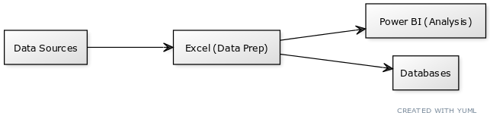

Architecture Diagram

Slide 8
List Of Modules
Operational Modules:
Data Input
Task Tracking
Sample Management
Defect Identification
Analysis and Reporting Modules:
Quality Scoring
Analytics and Reporting
User Interface
Continuous Improvement
Security and Compliance Features:
Security and Compliance
Notification and Alert
Training and Onboarding
System Maintenance and Customization:
Customization
Maintenance and Updates

Slide 9
Module Description
Data Management Module:
Efficiently input and import manufacturing data using Excel and Power BI, streamlining analysis and processing for enhanced decision-making.
Task and Sample Tracking Module:
Organize and monitor manufacturing tasks systematically in Excel, while overseeing sample tracking and analysis for data-driven decision-making across different stages.
Quality Control and Reporting Module:
Identify and classify defects within manufacturing processes, implement dynamic quality scoring in Power BI for real-time insights, and utilize advanced analytics tools to generate comprehensive reports.
User-Focused Modules:
Design and maintain user interfaces, support continuous improvement through data-driven decision-making, and ensure data security and compliance with encryption features in Excel and Power BI.

Slide 10
Conclusion
The project on analyzing product quality illustrates a careful method using both Excel and Power BI. The clear focus on specific quality aspects, where Excel handles initial data preparation and Power BI manages advanced analysis and visualization, showcases a strong emphasis on data. Diverse data sources and thorough preparation, where Excel plays a crucial role in initial cleaning and formatting, underscore the importance of a strong data-centric approach. The impactful role of Power Query in streamlining data refinement enhances analytical depth using Power BI's custom calculations. Visual storytelling and the use of DAX in Power BI improve data visualization, while validation procedures ensure the reliability of results. The project's detailed documentation and iterative improvements, guided by stakeholder feedback, demonstrate adaptability to changing business needs. Overall, the project shows effective use of data, providing insights into how Excel and Power BI work together for dynamic data analysis and quality assessment.

Slide 11
Future Enhancement
The future of the project involves using machine learning to actively manage quality and improving how data is updated in real-time. More advanced analysis methods, like predicting trends, and bringing in data from outside sources could give a fuller picture. Alerts in Power BI that happen automatically would help people respond quickly to important quality signals. Thinking about using natural language processing to understand sentiments and adding features for collaboration could help with making decisions together. Making the project able to handle bigger sets of data, possibly by using cloud technology, would be useful. Giving users more ways to personalize Power BI and looking at data about places could make the experience better for people involved. Checking out new technologies like blockchain and mobile apps would keep data safe and make it easier for people to access, making sure the project stays relevant for managing product quality in the future.

Slide 12
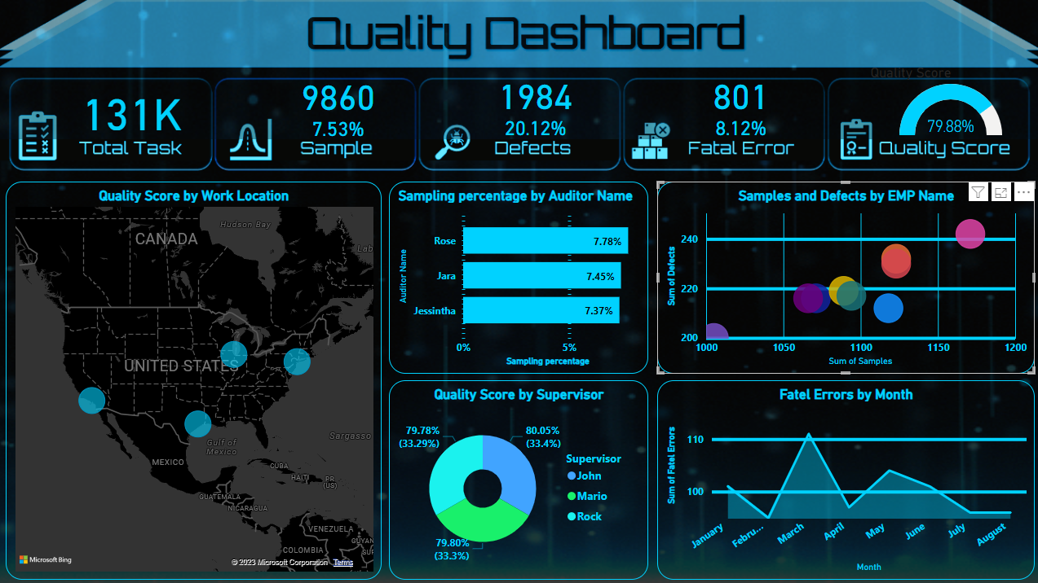
Output Demo

Slide 13
THANK YOU !

